Slide 1
Implementation of Grep Functionalities
Vishwakarma Institute of Technology, Pune
Department of IT and MCA
43. Prapti Maheshwari
68. Raj Shah
69. Anish Shaha
76. Vaishnav Sonawane
82. Vaibhavi Shetty
Under the guidance of
Prof. P. A. Bailke

Slide 2
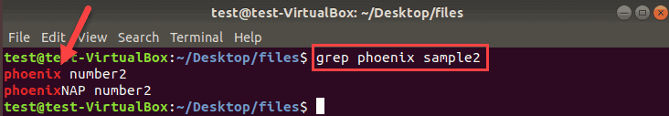
Grep Command
GREP : Global Regular Expression Print
The grep filter searches a file for a particular pattern of characters, and displays all lines that contain that pattern.
The pattern that is searched in the file is referred to as the regular expression.
Syntax of grep command:
grep [options] pattern [files]

Slide 3
Implementation of Grep Command ( grepg8 )
Name of Implemented Command : grepg8
Aim : Implementation of grep command.
Implemented features of grep command which is used for searching a term reliably through entire document.
Internally grepg8 searches term using regular expression.
Syntax of grepg8 command:
grepg8 [-A <#>|-f <file> -v|-V] <search term>
https://www.geeksforgeeks.org/write-regular-expressions/

Slide 4
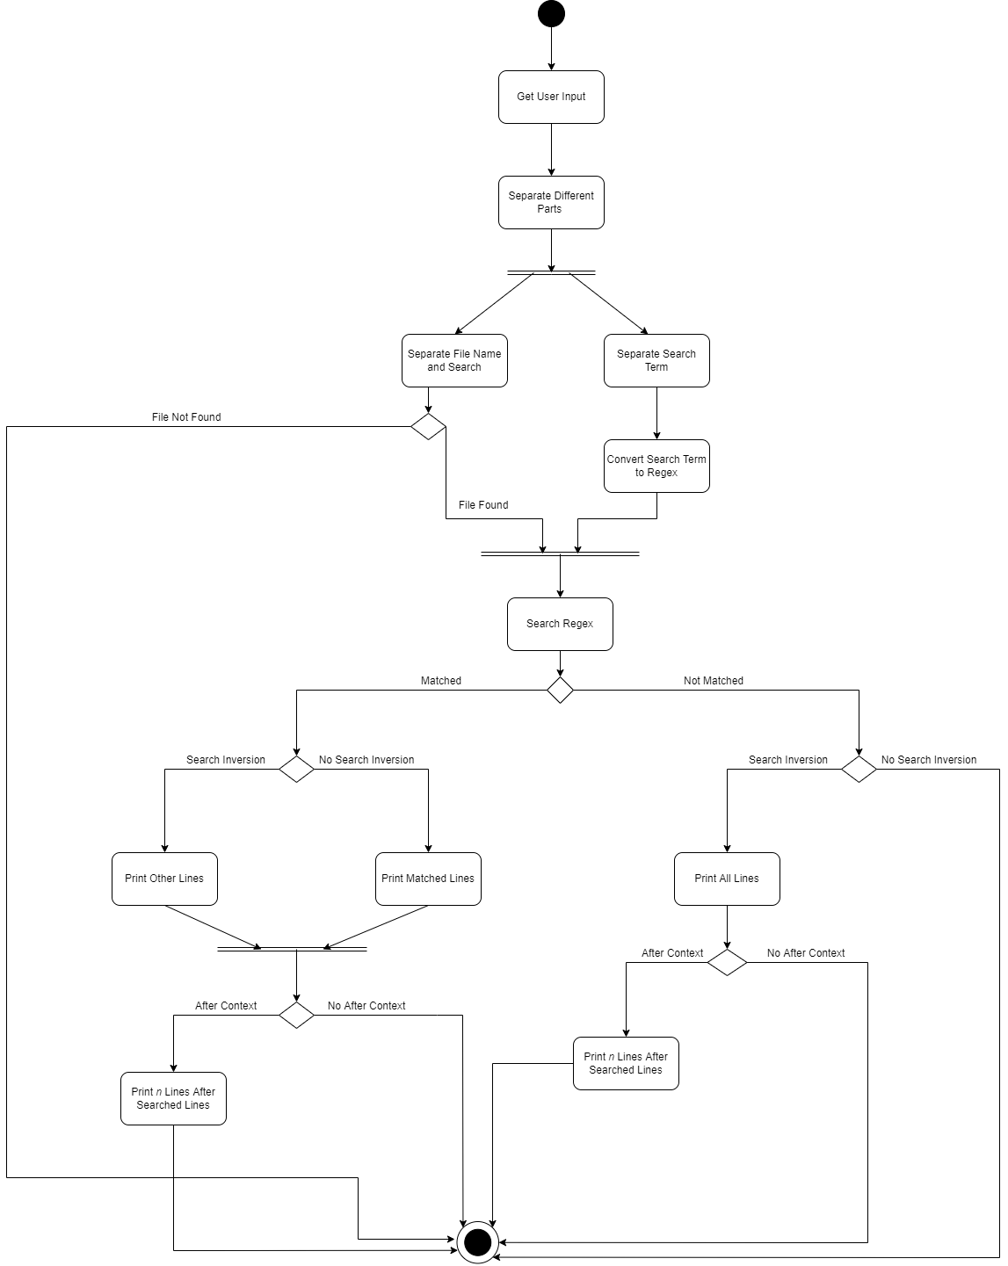
Activity Diagram of Project
States:
Receiving Input
Performing Validity Check
Processing User Input
Setting Parameters
Converting String to Regular Expression
Browsing File
Performing Regex Match
Printing Required Lines (Based on set options).
http://surl.li/avfvn

Slide 5
Options in grepg8 Command
-A (After Context) :
grepg8 will grab a number of lines after the line containing the <search term>.
-f (File Search) :
Signals grepg8 to only search the <file> for the <search term>.
-v (Search Inversion) :
Search for every line that does not include the <search term>.
-V (Enable Verbose) :
The file path to the file will be printed along with the search result.

Slide 6
Future Scope
Improvising Features of grep using parallelism.
Implementing Multithreading using OpenMP (Open Multi-Processing) Library in C++.

Slide 7
Thank You

